Slide 1

PREDICTIVE ANALYTICS WITH MACHINE LEARNING FOR FRAUD DETECTION OF ONLINE MARKETING TRANSACTIONS
by
L.Narayana Reddy
Roll No. 204G1A0565
K.Pushpa
Roll No. 204G1A0574
G.Uday Kiran
Roll No. 204G1A05B4
N.Sai Harsha Vardhan
Roll No. 204G1A0585
Under the guidance of
Mrs. N.Usha Sree M.Tech
Assistant Professor
Department of Computer Science and Engineering
Srinivasa Ramanujan Institute of Technology
(Autonomous)
2023 - 2024

Slide 2

Comments
Future extension.
Datasets train check.

Slide 3
Contents
Abstract
Introduction
Literature survey
Existing System
Proposed System
Planning
Design
Implementation
Research Paper
References
GitHub Link

Slide 4
Abstract
With the surge in online transactions, there's a parallel increase in data leakage, fraud, and threats, causing substantial losses to customers. Hence, online marketing systems are urgently adopting advanced security and data handling technologies. Machine Learning (ML), Deep Learning (DL), and Predictive Analytics have emerged as potent solutions for managing sensitive data and preemptively identifying fraud and anomalous behaviors. These technologies efficiently analyze massive datasets, learn from historical patterns, and make accurate predictions, thus providing robust security to online transactions. Through continuous learning and adaptation, ML, DL, and Predictive Analytics significantly enhance the reliability and safety of online marketing systems, instilling confidence among users and stakeholders alike. Their implementation is imperative for safeguarding digital assets, personal data, and ensuring a secure and trustworthy online transaction environment.

Slide 5
Introduction
With the surge in online transactions, ensuring security and reliability has become paramount. ML has emerged as a pivotal solution, offering un-paralleled capabilities in managing and safeguarding sensitive transactional data. ML algorithms adeptly analyze extensive datasets from online transactions, learning and identifying normal and anomalous behaviors and patterns. This learned intelligence allows systems to promptly recognize and respond to potential security threats, thereby minimizing risks and preventing fraudulent activities. ML provides a dynamic and robust security framework for online transactions. It empowers online marketing systems with predictive accuracy and operational efficiency, significantly reducing the incidence of data breaches and fraud. Furthermore, the implementation of ML instills confidence among users and stakeholders by ensuring a secure, reliable, and trustworthy digital transaction environment, making it an indispensable technology in the realm of online transactions.

Slide 6
Problem Statement
Current tools for real-time fraud detection in online marketing transactions lack user-friendliness and accessibility. There is a need for a web application that simplifies the process of inputting transaction data and obtaining instant fraud risk assessments, ensuring that businesses, even those without extensive technical knowledge, can efficiently protect themselves from online fraud.
Traditional fraud detection methods are often reactive and fail to adapt to emerging fraud patterns. To maintain a high level of fraud detection accuracy, businesses require a predictive analytics system capable of learning and adjusting to the latest fraud tactics. The challenge is to develop a predictive model that not only identifies known fraud patterns but also anticipates and counters new ones.

Slide 7
Objectives of Project
Develop a user-friendly web application that integrates machine learning models for real-time fraud detection in online marketing transactions. The application should allow users to input transaction data, and the system will provide immediate fraud risk assessment.
Train, deploy, and fine-tune machine learning models for predictive analytics in the detection of fraudulent online marketing transactions. Utilize historical transaction data and real-time monitoring to continuously improve the accuracy and efficiency of the fraud detection system.

Slide 8
Literature survey for first objective
S. NO | Journal Type with year | Authors | Title | Outcomes
1 | IEEE, 2020 | Taha, Altyeb & Malebary, Sharaf. | An Intelligent Approach to Credit Card Fraud Detection Using an Optimized Light Gradient Boosting Machine | Fundamentals of Boosting Techniques.
2 | IEEE .(2019). | Assaghir, Zainab & Taher, Yehia & Haque, Rafiqul | An Experimental Study With Imbalanced Classification Approaches for Credit Card Fraud Detection | Basics of Imbalanced Data Treatment.

Slide 9
Existing System
In existing system, models are build based on Logistic Regression and K-Means clustering to estimate fraudulent and non-fraudulent transactions. This techniques gives low precision scores and recall scores and also lacks the robustness because of higher computational time.
Disadvantages:
Low Precision: Logistic Regression and K-Means often yield low precision, misclassifying legitimate transactions, which negatively affects the system's overall reliability and user trust.
Poor Recall Scores: With low recall scores, these models frequently fail to identify fraudulent transactions, leading to increased financial risks and potential losses.

Slide 10
Existing System
High Computational Time: Both techniques require significant computational time, especially with large datasets, leading to slower response times and reduced system efficiency.
Lack of Robustness: The models are not robust enough to adapt to the constantly evolving patterns and tactics employed by fraudulent actors online.
Over-Simplification: Logistic Regression and K-Means sometimes overly simplify complex transaction

Slide 11
Proposed System
We propose this system to investigate a problem of whether it is valuable or not to use machine learning techniques to detect whether the credit card is fraud or not fraud using Decision Trees, KNN Classifier, Random Forest Algorithm.
Advantages:
Enhanced Fraud Detection: Machine learning techniques swiftly identify and prevent fraudulent transactions, significantly reducing financial losses for both businesses and consumers.
Accurate Predictions: Utilizing Decision Trees, KNN, and Random Forest algorithms, the system offers accurate and reliable predictions for credit card transaction authenticity.

Slide 12
Proposed System
Accurate Predictions: Utilizing Decision Trees, KNN, and Random Forest algorithms, the system offers accurate and reliable predictions for credit card transaction authenticity.
Adaptive Learning: The proposed system continuously learns and adapts to new fraudulent tactics, ensuring up-to-date protection against emerging credit card fraud patterns.
Efficient Processing: Machine learning enables real-time analysis of transaction data, providing instant fraud detection without compromising the transaction processing speed.
User Trust and Confidence: Implementing advanced fraud detection mechanisms enhances user trust and confidence in online transactions, fostering a secure digital transaction environment for customers.

Slide 13
Planning
Software Requirements:
Hardware Requirements:
Processor - I3/Intel Processor
Hard Disk -160GB
RAM - 8Gb
Software Requirements:
Operating System : Windows 7/8/10
IDE : Pycharm.
Libraries Used : Numpy, Pandas, OS,Flask.
Technology : Python 3.6+

Slide 14
Planning
Modules
1.System Modules:
1.1 Store data
1.2 Model Training
1.3 Model Predictions
1.4 Graph Generation
2.User Modules:
2.1 Load Dataset
2.2 View Dataset
2.3 Select Model
2.4 Prediction
2.5 Graphs

Slide 15
Planning
Task Data set:
The dataset for the Fraud data is collected from the kaggle website (kaggle.com).
Pre-processing:
• In preprocessing first of all we will check whether there is any Nan values.
• If any Nan values is present we will fill the Nan values with different fillna techniques
like bfill, ffill, mode, and mean.
• Here we used the ffill (front fill) technique on our project.

Slide 16
Planning
Training the data:
Irrespective of the algorithm we select the training is the same for every algorithm.
Given a dataset we split the data into two parts training and testing, the reason behind doing this is to test our model/algorithm performance just like the exams for a student the testing is also exam for the model.
We can split data into anything we want but it is just good practice to split the data such that the training has more data than the testing data, we generally split the data.
And for training and testing there are two variables X and Y in each of them, the X is the features that we use to predict the Y target and same for the testing also.

Slide 17
Design-Use Case Diagram
Fig 1 : Use case Diagram

Slide 18
Design-Sequence Diagram
Fig 2 : Sequence diagram

Slide 19
Design-Activity Diagram
Fig 3 : Activity diagram

Slide 20
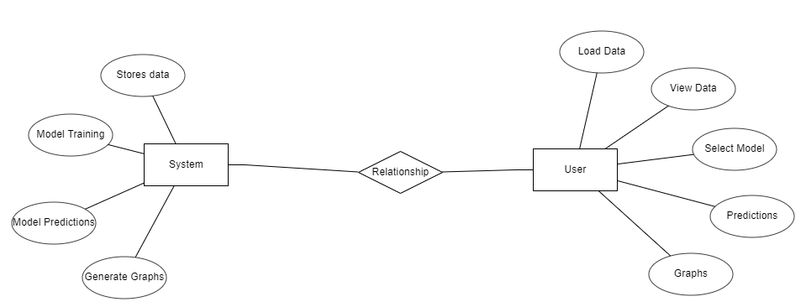
Design-ER Diagram
Fig 4 : ER Diagram

Slide 21
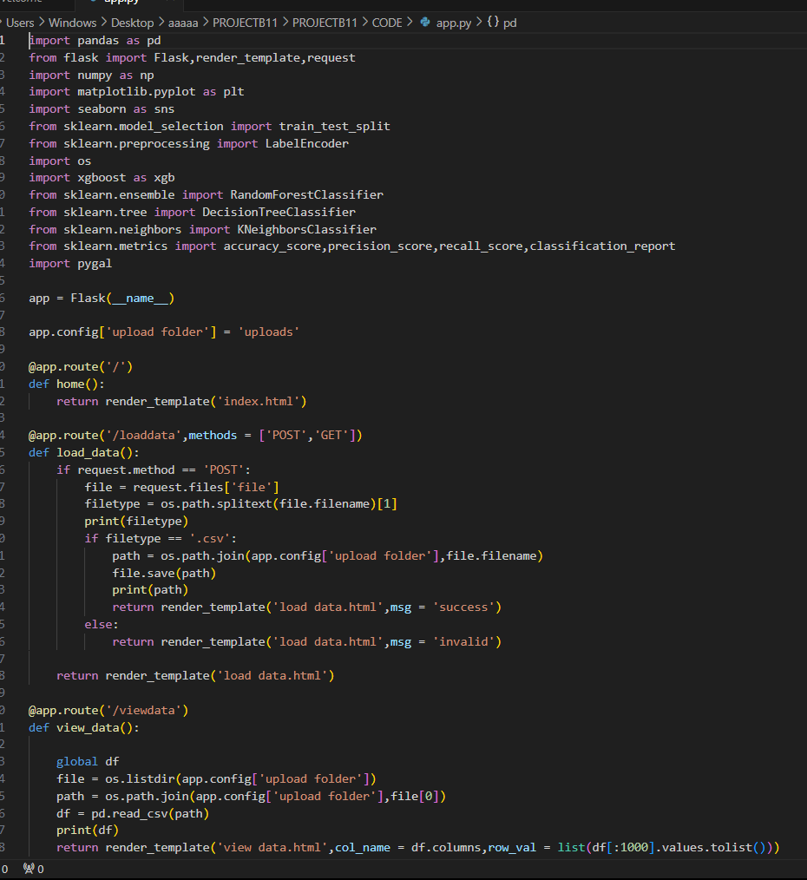
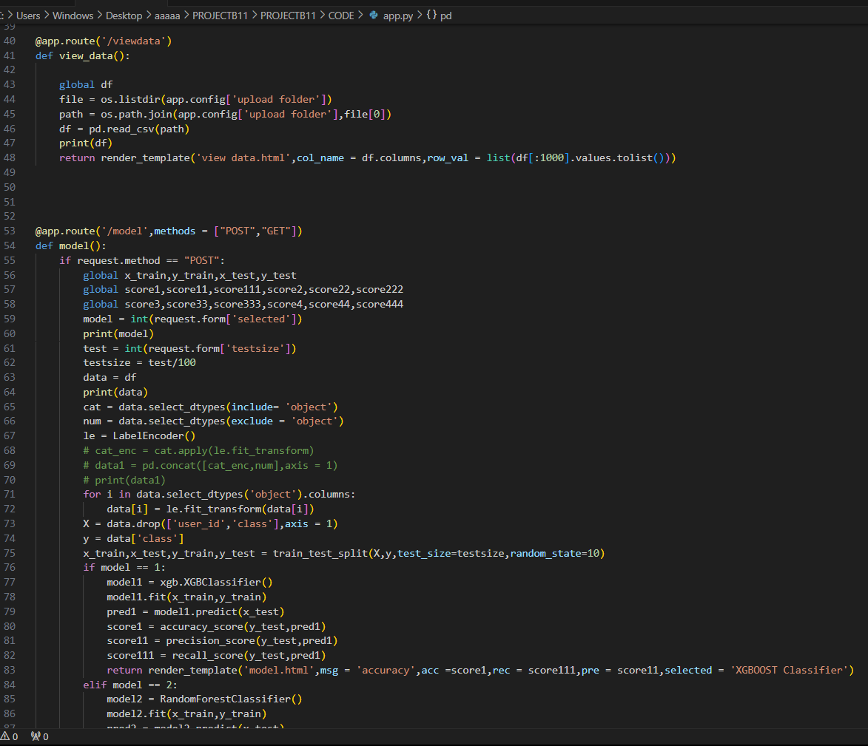
Implementation

Slide 22
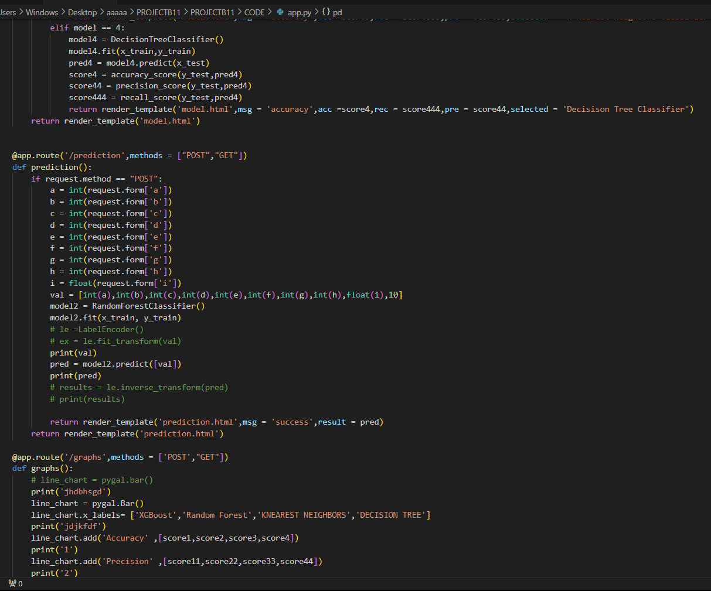
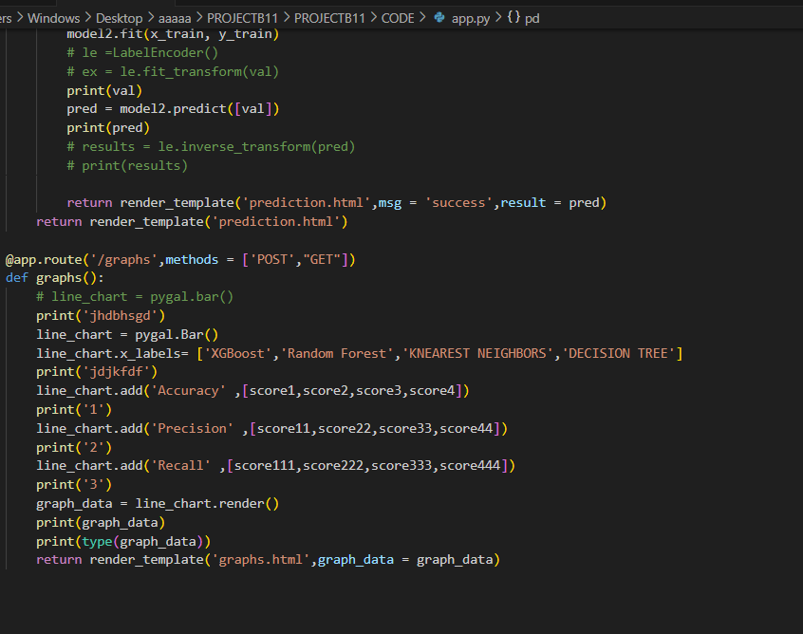
Implementation

Slide 23
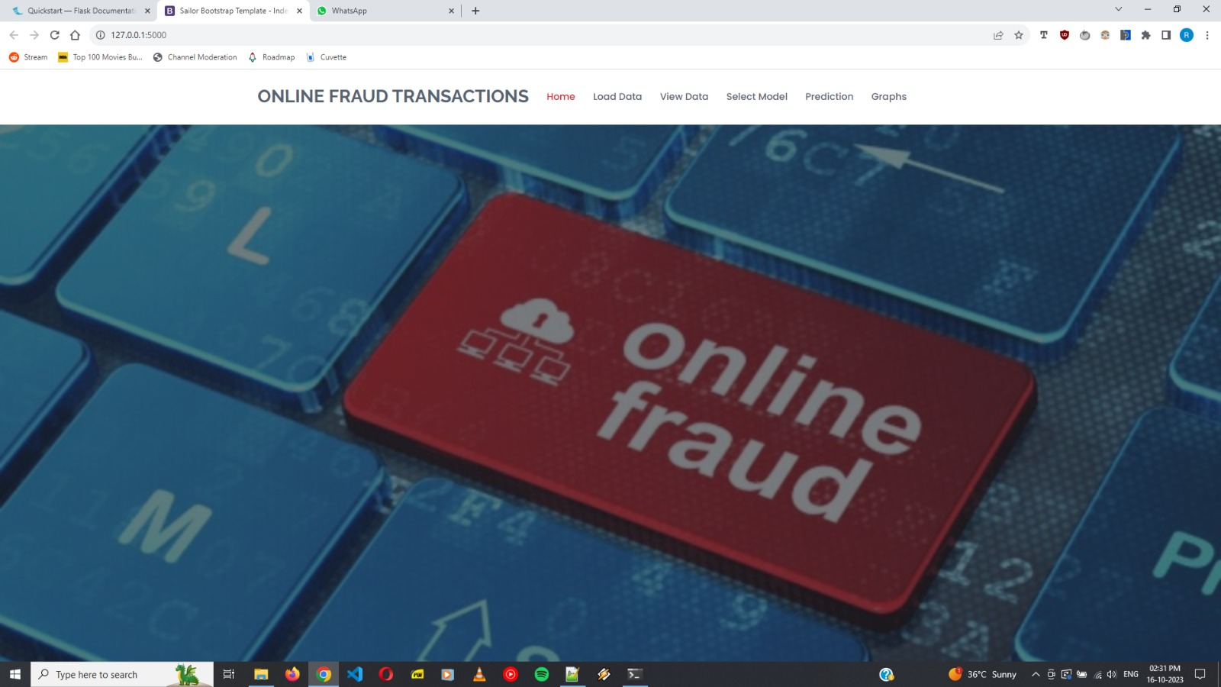
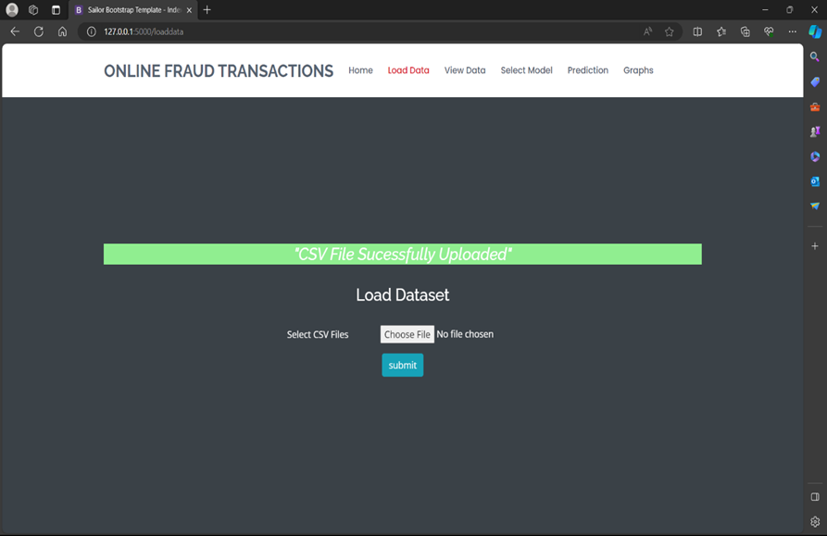
Design and implementation of Second objective

Slide 24
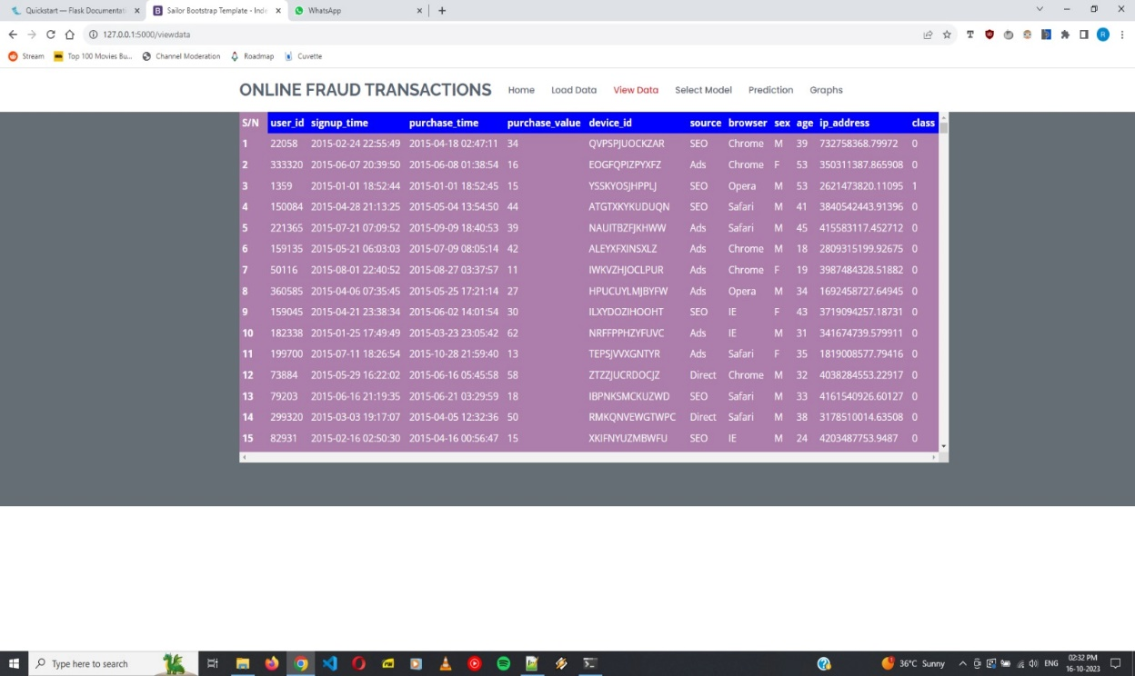
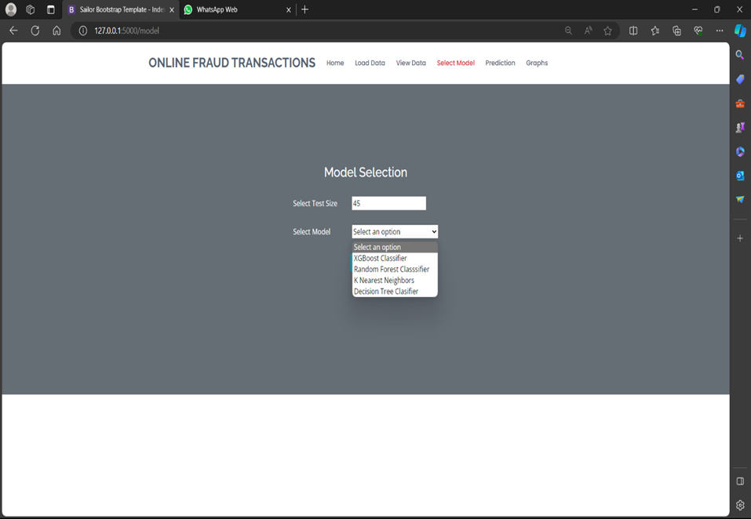
Design and Implementation of Second objective

Slide 25
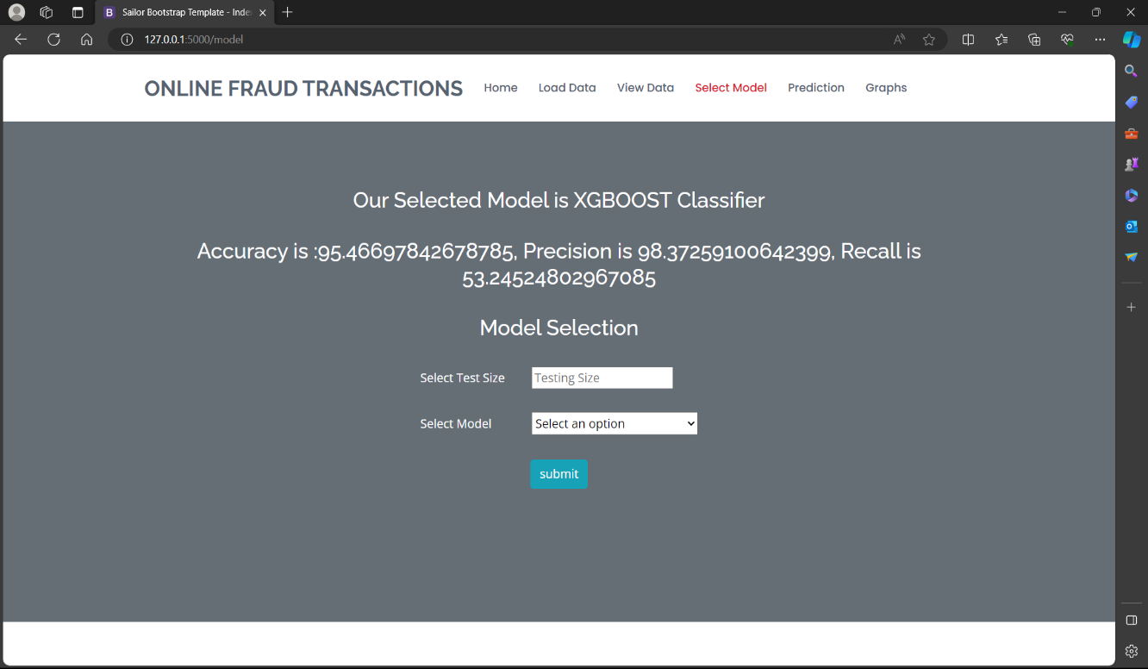
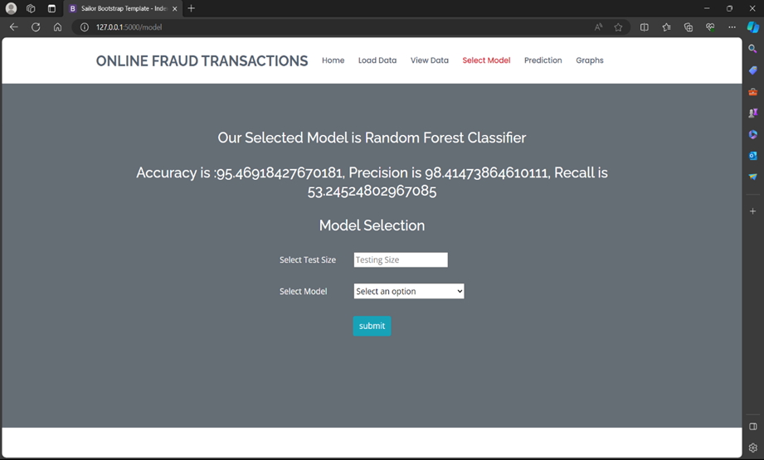
Design and Implementation of Second objective

Slide 26
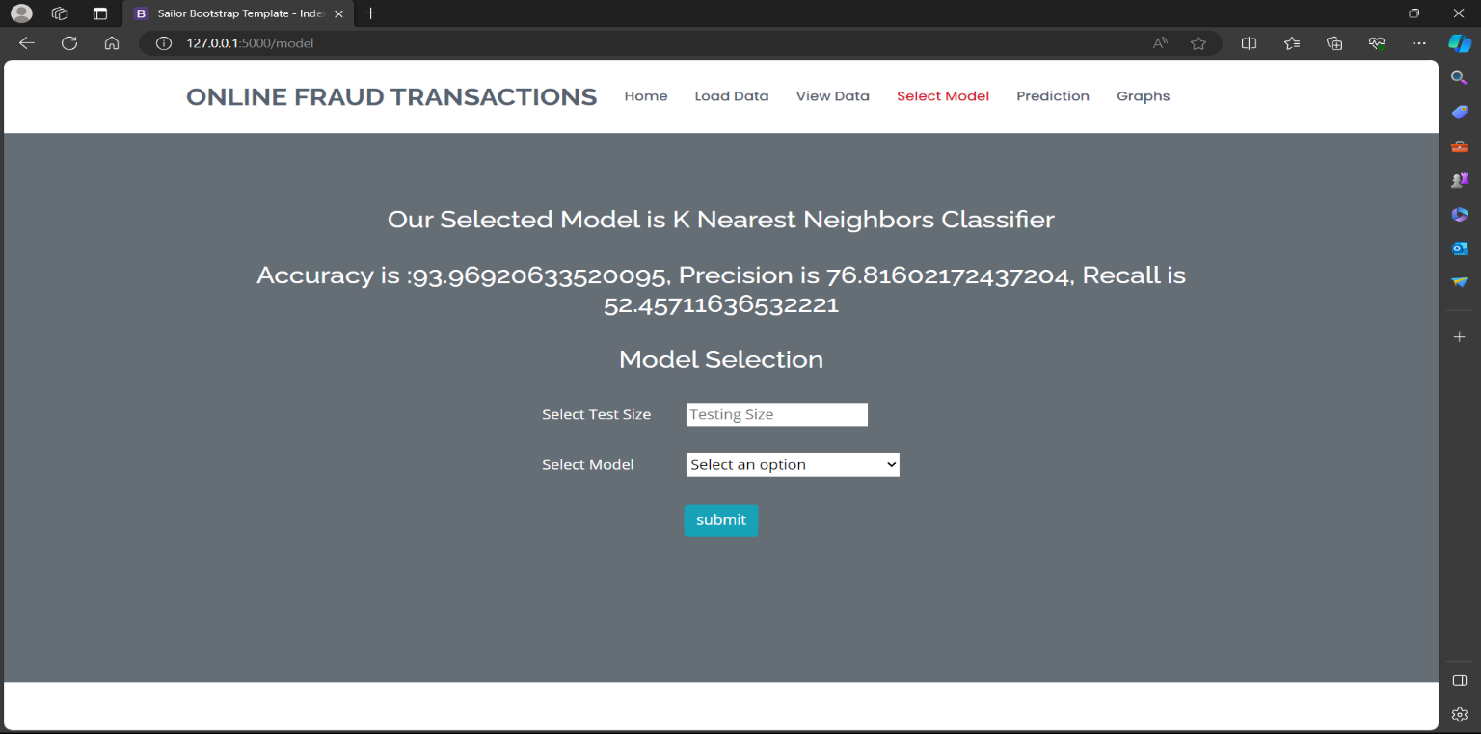

Design and Implementation of Second objective

Slide 27
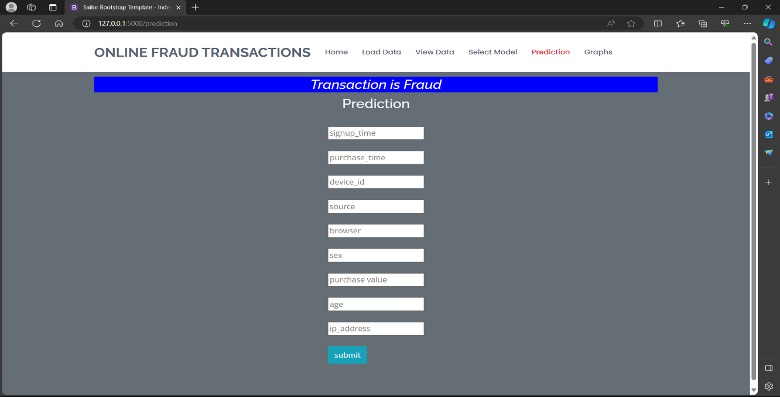
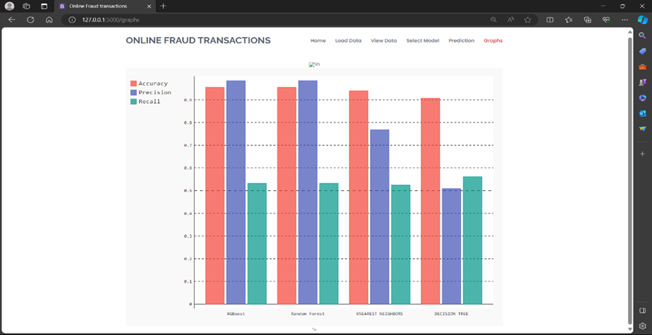
Design and Implementation of Second objective

Slide 28
Research Paper
Research paper

Slide 29
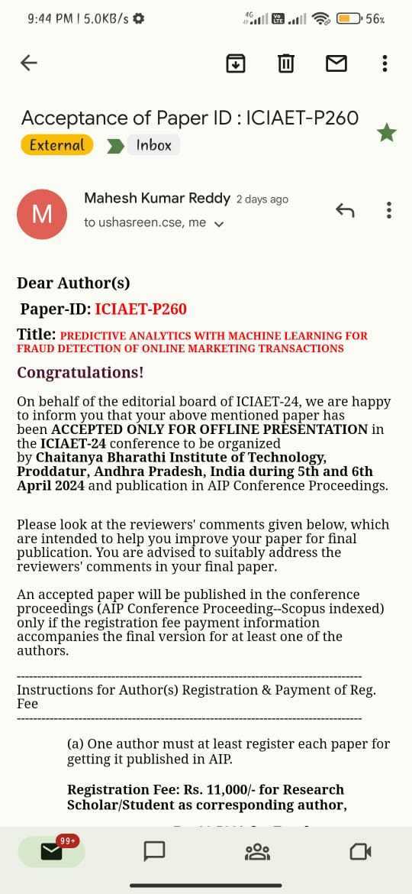
Acknowledgement

Slide 30
References
[1].IEEE, 2020Taha, Altyeb & Malebary, Sharaf. “An Intelligent Approach to Credit Card Fraud Detection Using an Optimized Light GradientBoosting Machine Fundamentals of Boosting Techniques”.
[2]. IEEE .(2019).Assaghir, Zainab & Taher, Yehia & Haque, Rafiqul "An Experimental Study With Imbalanced Classification Approaches for Credit Card Fraud Detection Basics of Imbalanced Data Treatment”.
[3]. IJRASET, (2021), A Sampath Abhishek, “Predictive Analytics with Machine Learning For Fraud Detection”.
[4]. Information Sciences, Elsevier (2019), F. Carcillo, Y.-A. Le Borgne and O. Caelen et al, “Combining unsupervised and supervised learning in credit card fraud detection Fundamentals of Machine Learning”.

Slide 31

Git Hub Dashboards of each student
GitHub Link :https://github.com/204g1a0565/CSE-2020-24-Batch-B11

Slide 32
Thank you!!!

